Slide 1
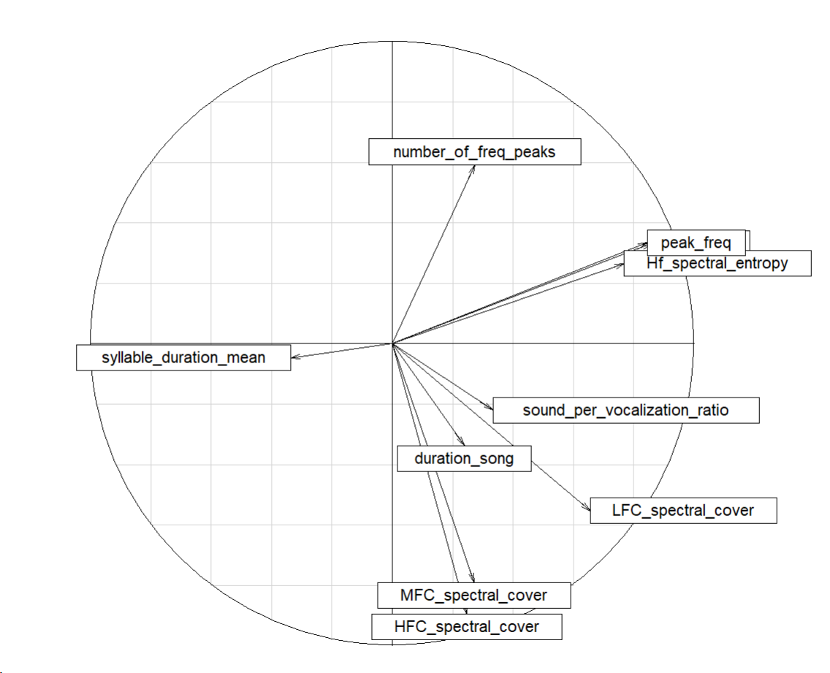
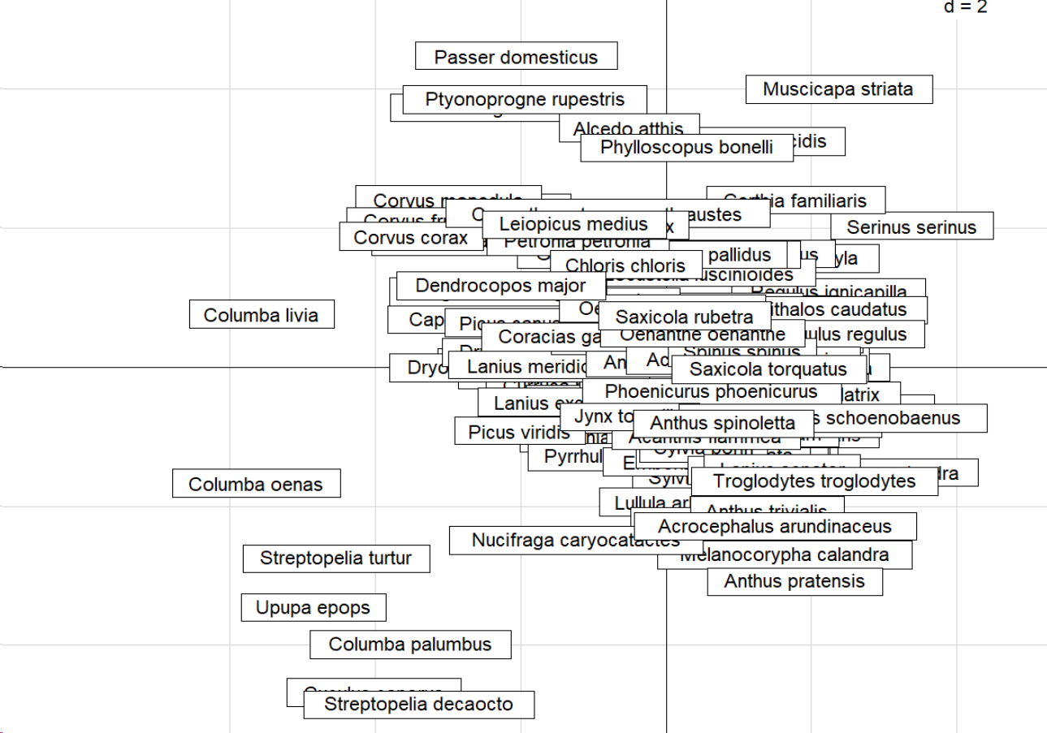
Acoustic trait space – axes 1 vs 2

Slide 2
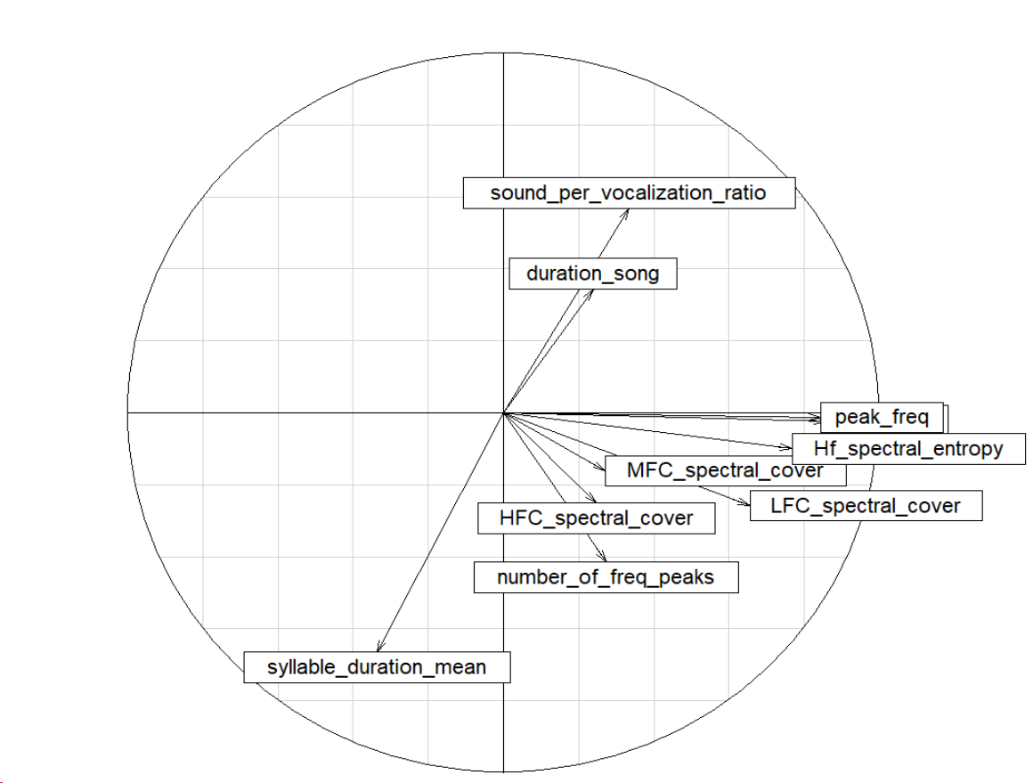
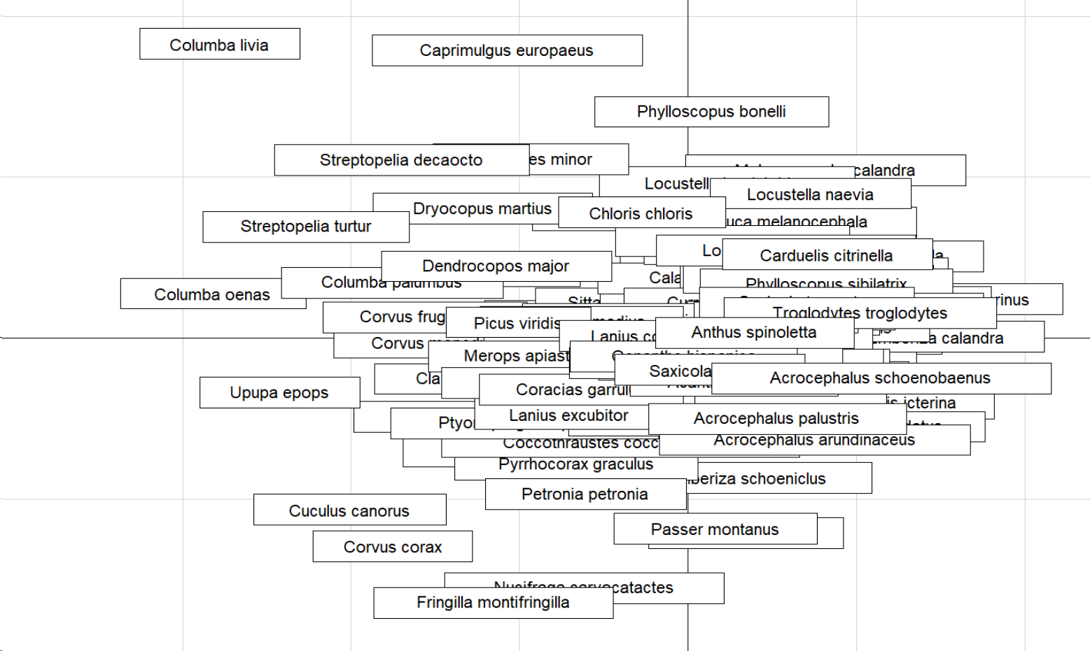
Acoustic trait space – axes 1 vs 3

Slide 3
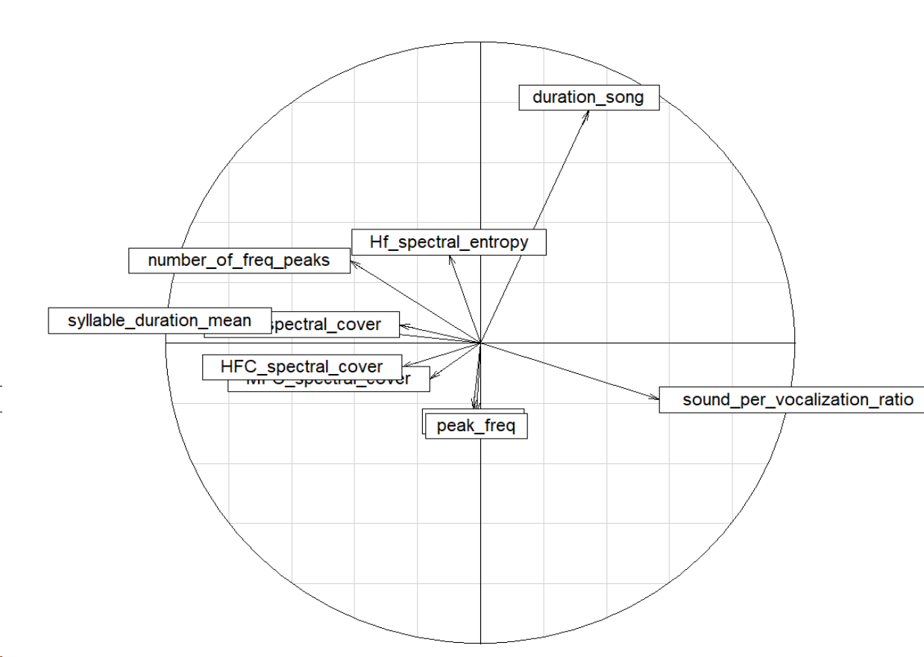
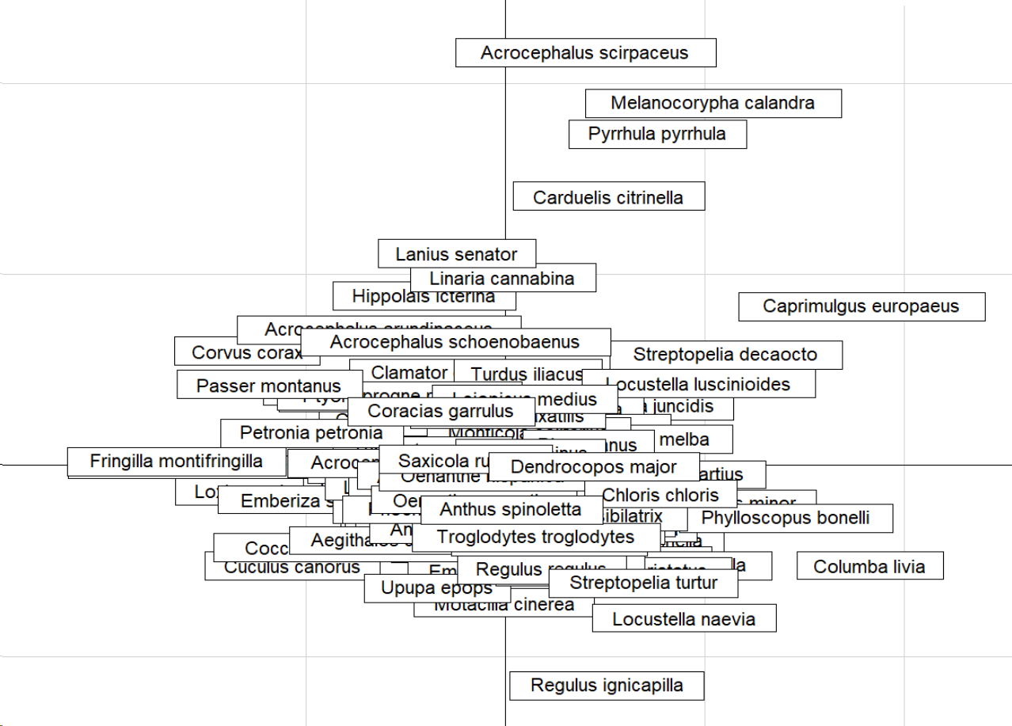
Acoustic trait space – axes 3 vs 4

Slide 4
Summary : acoustic trait space
Axis 4 = total song duration
Axis 3 = rythm
Axis 2 = spectral composition (~bandwidth)
Axis 1 = main frequency

Slide 5
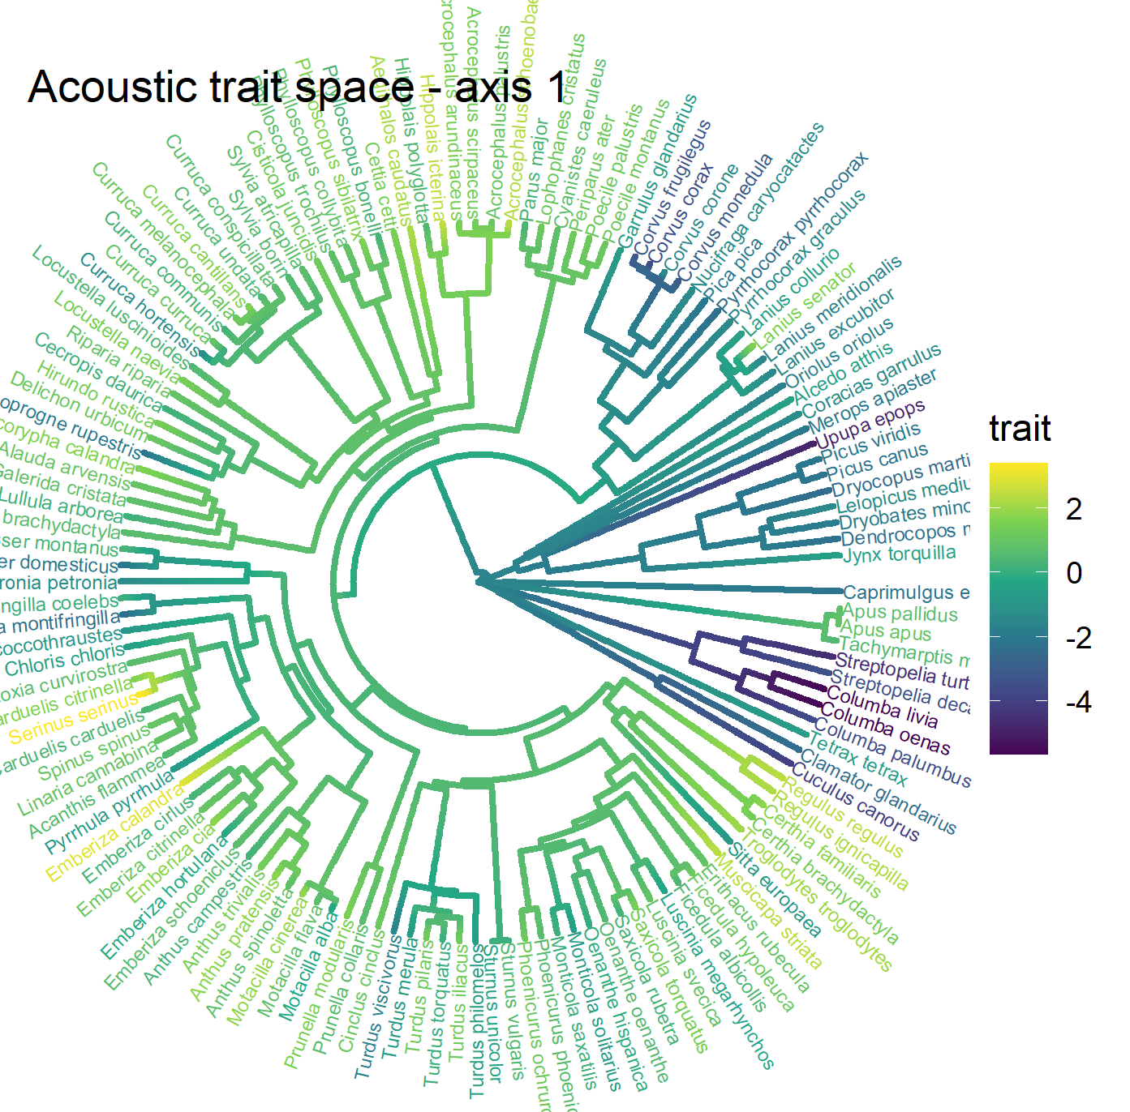
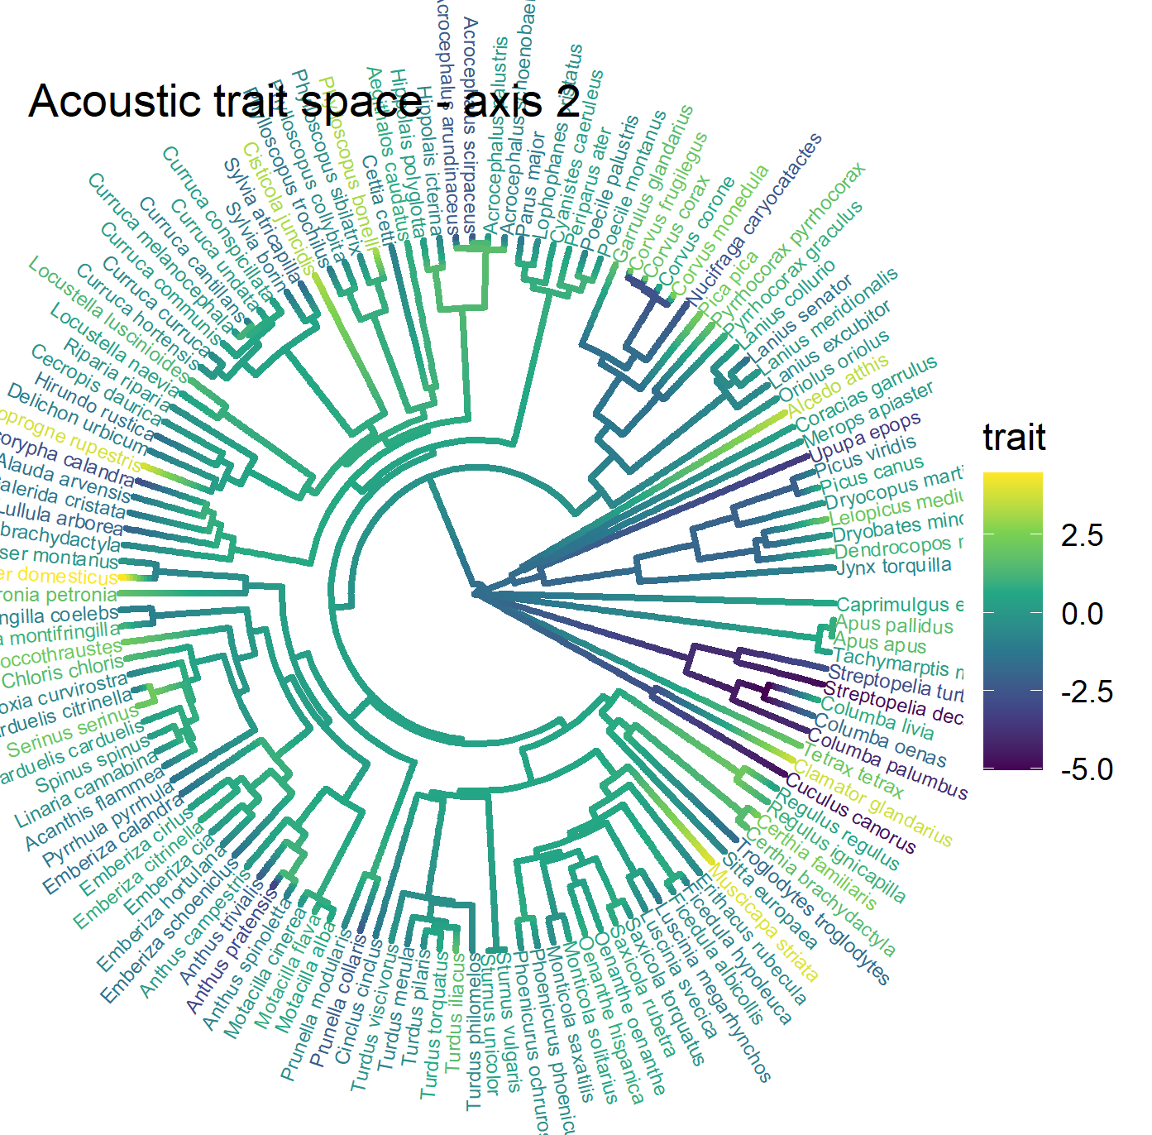
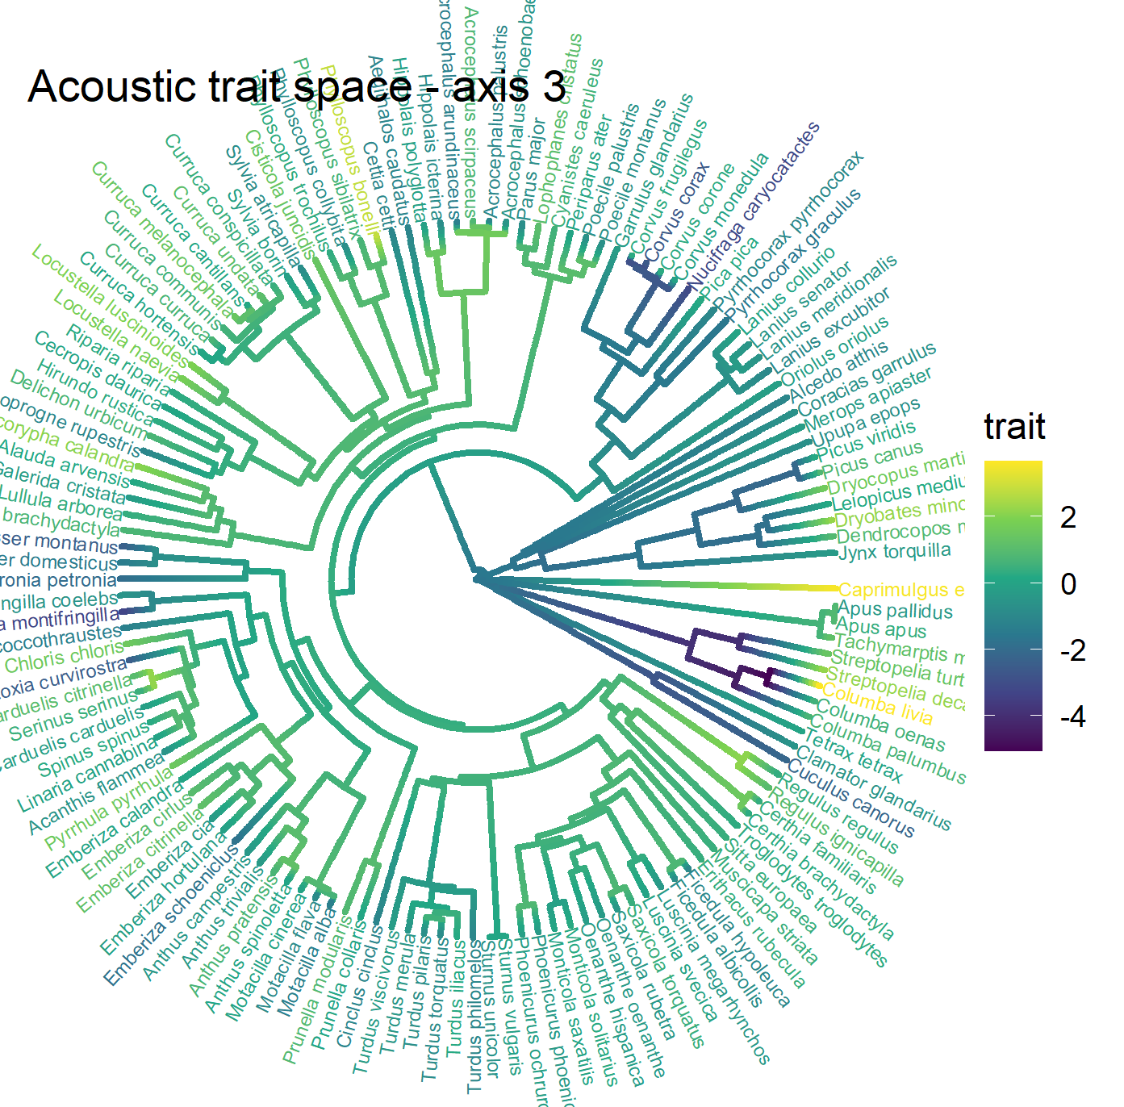
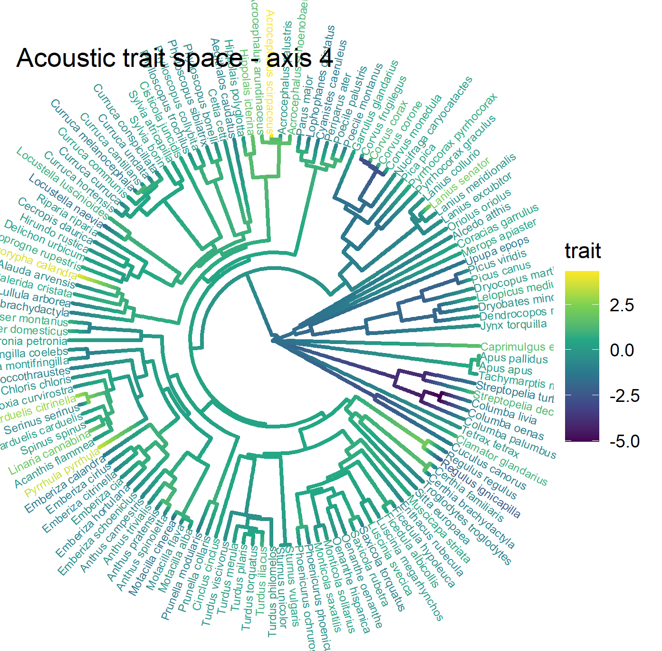
Phylogenetic structure of the four axes of the acoustic trait space

